Slide 1
Linked Structures
(Stacks, Queues)
Chapter 5
2nd Ed Page 265
3rd Ed Page 280
BSc in Software Development
Computer Science 1 2008/09
Notes:
BSc in Software Development - Year 2
Computer Science 1
Stacks and Queues

Slide 2
Implementing a Stack as a Linked Structure Pg 266/280
Allows dynamic allocation of space for each stack element as required.
Therefore a fixed amount of space does not need to be set aside
  wasting space if fewer elements are used or
  running out of space if more elements are required.
Need to keep a pointer to the top of the stack
BSc in Software Development
Computer Science 1 2008/09

Slide 3
C++ linked implementation of the Stack ADT –
Declaration ( .h file)
// Class is templated.
template <class ItemType>
struct NodeType;
template<class ItemType>
class StackType
{
public:
StackType();
// Class constructor.
~StackType();
// Class destructor.
BSc in Software Development
Computer Science 1 2008/09

Slide 4
void MakeEmpty();
// Function: Sets stack to an empty state.
// Post: Stack is empty.
bool IsFull() const;
// Function: Determines whether the stack
// is full.
// Pre: Stack has been initialized.
// Post: Function value = (stack is full)
bool IsEmpty() const;
// Function: Determines whether the stack
// is empty.
// Pre: Stack has been initialized.
// Post: Function value = (stack is empty)
BSc in Software Development
Computer Science 1 2008/09

Slide 5
void Push(ItemType item);
// Function: Adds newItem to the top of
// the stack.
// Pre: Stack has been initialized and is
// not full.
// Post: newItem is at the top of the
// stack.
void Pop(ItemType& item);
// Function: Removes top item from the
// stack and returns it in item.
// Pre: Stack has been initialized and is
// not empty.
// Post: Top element has been removed from
// stack. item is a copy of the removed item.
BSc in Software Development
Computer Science 1 2008/09

Slide 6
private:
NodeType<ItemType>* topPtr;
};
BSc in Software Development
Computer Science 1 2008/09

Slide 7
C++ linked implementation of the Stack ADT –
Definition ( .cpp file)
// Implementation file for Stack ADT.
// Class definition is in "Stack4.h".
// Class is templated; implementation is linked.
#include <stddef.h>
template <class ItemType>
struct NodeType
{
ItemType info;
NodeType<ItemType>* next;
};
BSc in Software Development
Computer Science 1 2008/09

Slide 8
template<class ItemType>
StackType<ItemType>::StackType()
{
topPtr = NULL;
}
template <class ItemType>
StackType<ItemType>::~StackType()
{
NodeType<ItemType>* tempPtr;
while (topPtr != NULL)
{
tempPtr = topPtr;
topPtr = topPtr->next;
delete tempPtr;
}
}
BSc in Software Development
Computer Science 1 2008/09

Slide 9
template<class ItemType>
void StackType<ItemType>::Pop(ItemType& item)
{
NodeType<ItemType>* tempPtr;
item = topPtr ->info;
tempPtr = topPtr;
topPtr = topPtr->next;
delete tempPtr;
}
BSc in Software Development
Computer Science 1 2008/09

Slide 10
Function Pop
Save off the pointer value to the top node
NodeType<ItemType>* tempPtr;
tempPtr = topPtr;
Set item to Info(top node)
item = topPtr ->info;
Unlink the top node from the stack
topPtr = topPtr->next;
Deallocate the old top node
delete tempPtr;
BSc in Software Development
Computer Science 1 2008/09

Slide 11
Popping a Linked Stack:
topPtr .info .next .info .next
'E' 'D'
Popping a stack with more than one node:
topPtr .info .next
'D'
Poppng a stack with only one node:
topPtr
BSc in Software Development
Computer Science 1 2008/09

Slide 12
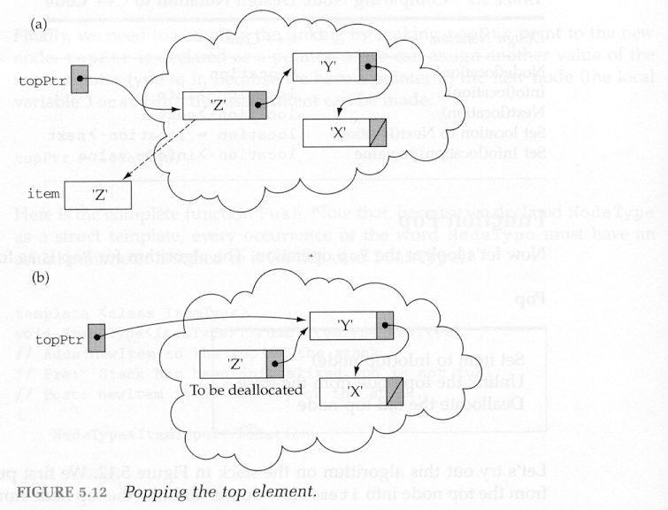
Popping the top element off a stack.
This is what you want to happen.
BSc in Software Development
Computer Science 1 2008/09

Slide 13
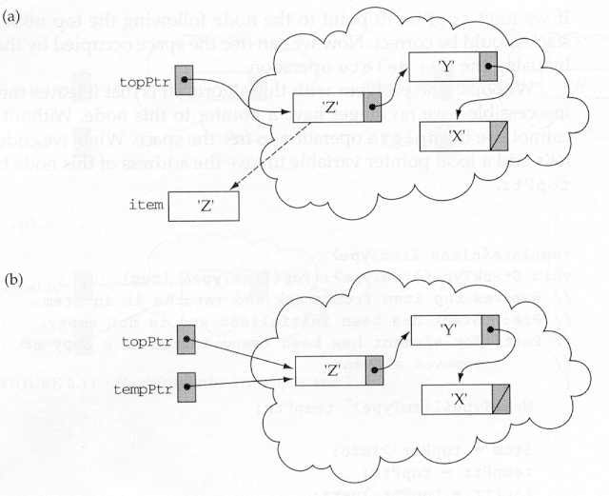
This is how it should happen.
item = topPtr->info;
tempPtr = topPtr;
BSc in Software Development
Computer Science 1 2008/09

Slide 14
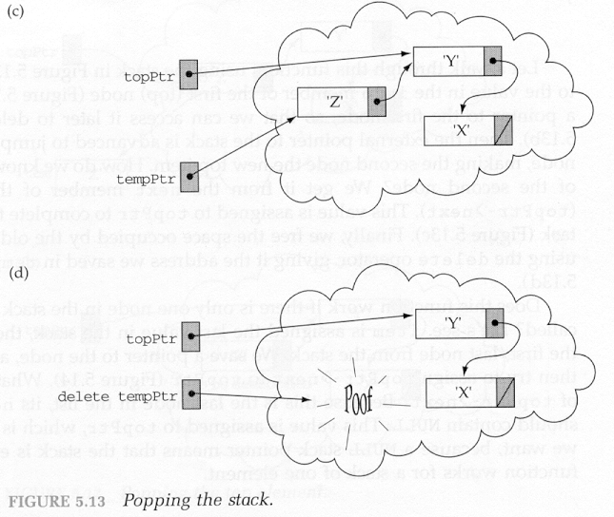
This is how it should happen (cont.)
topPtr = topPtr->next;
delete tempPtr;
BSc in Software Development
Computer Science 1 2008/09

Slide 15
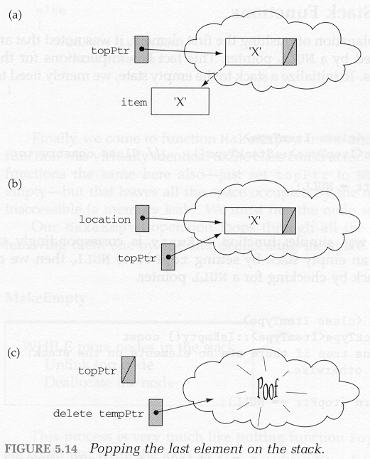
Popping the last element on the stack
item = topPtr->info;
tempPtr
tempPtr = topPtr;
topPtr = topPtr->next;
delete tempPtr;
BSc in Software Development
Computer Science 1 2008/09

Slide 16
template <class ItemType>
void StackType<ItemType>::Push(ItemType newItem)
{
NodeType<ItemType>* location;
location = new NodeType<ItemType>;
location->info = newItem;
location->next = topPtr;
topPtr = location;
}
BSc in Software Development
Computer Science 1 2008/09

Slide 17
Function Push
Allocate space for new item
NodeType<ItemType>* location;
location = new NodeType<ItemType>;
Put new item into the allocated space
location->info = newItem;
Put the allocated space into the stack
  Chain all the elements together (link them all together)
  Each element in this linked stack is called a “node”
location->next = topPtr;
topPtr = location;
BSc in Software Development
Computer Science 1 2008/09

Slide 18
Pushing a Linked Stack:
topPtr
Pushing the first element onto the stack:
topPtr .info .next
'D'
Pushing the next element onto the stack:
topPtr .info .next .info .next
'E' 'D'
BSc in Software Development
Computer Science 1 2008/09

Slide 19
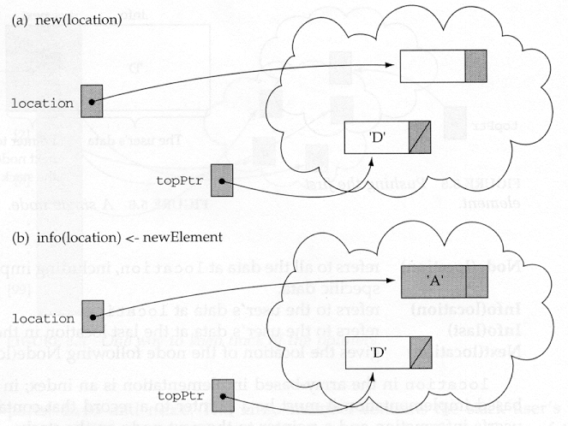
A Second Push Operation
location = new NodeType<ItemType>;
location->info = newItem;
BSc in Software Development
Computer Science 1 2008/09

Slide 20
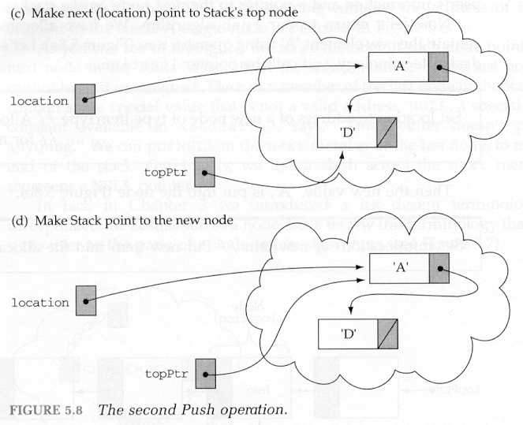
A Second Push Operation (cont)
location->next = topPtr;
topPtr = location;
BSc in Software Development
Computer Science 1 2008/09

Slide 21
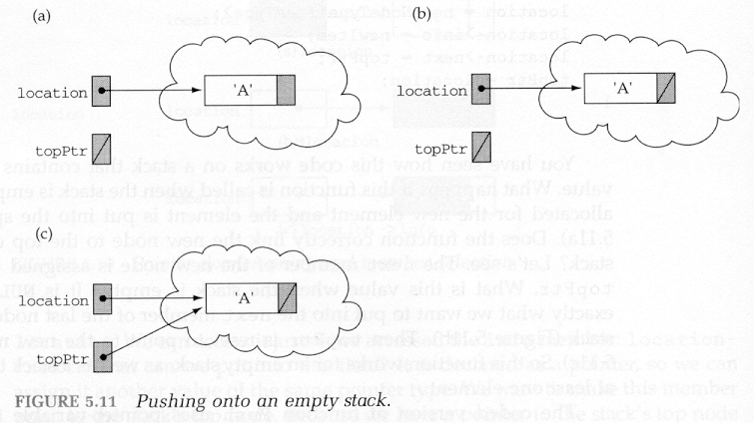
Pushing onto an empty stack
location = new NodeType<ItemType>;
(a) location->info = newItem;
(b) location->next = topPtr;
(c) topPtr = location;
BSc in Software Development
Computer Science 1 2008/09

Slide 22
template<class ItemType>
bool StackType<ItemType>::IsFull() const
{
NodeType<ItemType>* ptr;
ptr = new NodeType<ItemType>;
if (ptr == NULL)
return true;
else
{
delete ptr;
return false;
}
}
BSc in Software Development
Computer Science 1 2008/09

Slide 23
template <class ItemType>
bool StackType<ItemType>::IsEmpty() const
{
return (topPtr == NULL);
}
BSc in Software Development
Computer Science 1 2008/09

Slide 24
template <class ItemType>
void StackType<ItemType>::MakeEmpty()
{
NodeType<ItemType>* tempPtr;
while (topPtr != NULL)
{
tempPtr = topPtr;
topPtr = topPtr->next;
delete tempPtr;
}
}
BSc in Software Development
Computer Science 1 2008/09

Slide 25
Implementing a Queue as a Linked Structure Pg 284/296
Allows dynamic allocation of space for each queue element as required.
Therefore a fixed amount of space does not need to be set aside
  wasting space if fewer elements are used or
  running out of space if more elements are required.
Need to keep a pointer to the front of the queue and a pointer to the rear of the queue.
BSc in Software Development
Computer Science 1 2008/09

Slide 26
C++ linked implementation of the Queue ADT –
Declaration ( .h file)
template <class ItemType>
struct NodeType;
template <class ItemType>
class QueType
{
public:
QueType();
// Class constructor.
// Because there is a default constructor, the precondition that the queue
// has been initialized is omitted.
~QueType();
// Class destructor.
BSc in Software Development
Computer Science 1 2008/09

Slide 27
void MakeEmpty();
// Function: Initializes the queue to an
// empty state.
// Post: Queue is empty.
bool IsEmpty() const;
// Function: Determines whether the queue
// is empty.
// Post: Function value = (queue is empty)
bool IsFull() const;
// Function: Determines whether the queue
// is full.
// Post: Function value = (queue is full)
BSc in Software Development
Computer Science 1 2008/09

Slide 28
void Enqueue(ItemType newItem);
// Function: Adds newItem to the rear of
// the queue.
// Pre: Queue is not full.
// Post: newItem is at the rear of the
// queue.
void Dequeue(ItemType& item);
// Function: Removes front item from the
// queue and returns it in item.
// Pre: Queue is not empty.
// Post: Front element has been removed
// from the queue.
// item is a copy of the removed element.
BSc in Software Development
Computer Science 1 2008/09

Slide 29
private:
NodeType<ItemType>* qFront;
NodeType<ItemType>* qRear;
};
BSc in Software Development
Computer Science 1 2008/09

Slide 30
C++ linked implementation of the Queue ADT –
Definition ( .cpp file)
// Implementation file for Queue ADT; class
// specification in file Queue2.h.
// Class is templated.
// Uses linked list of items with a pointer to the head and one to the tail.
#include <stddef.h> // For NULL
template <class ItemType>
struct NodeType
{
ItemType info;
NodeType* next;
};
BSc in Software Development
Computer Science 1 2008/09

Slide 31
template <class ItemType>
QueType<ItemType>::QueType()
// Class constructor.
// Post: qFront and qRear are set to NULL.
{
qFront = NULL;
qRear = NULL;
}
template <class ItemType>
QueType<ItemType>::~QueType()
// Class destructor.
{
MakeEmpty();
}
BSc in Software Development
Computer Science 1 2008/09

Slide 32
template <class ItemType>
void QueType<ItemType>::MakeEmpty()
// Post: Queue is empty; all elements have been
// deallocated.
{
NodeType<ItemType>* tempPtr;
while (qFront != NULL)
{
tempPtr = qFront;
qFront = qFront->next;
delete tempPtr;
}
qRear = NULL;
}
BSc in Software Development
Computer Science 1 2008/09

Slide 33
template <class ItemType>
bool QueType<ItemType>::IsFull() const
// Returns true if there is no room for another
// ItemType on the free store;
// false otherwise.
{
NodeType<ItemType>* ptr;
ptr = new NodeType<ItemType>;
if (ptr == NULL)
return true;
else
{
delete ptr;
return false;
}
}
BSc in Software Development
Computer Science 1 2008/09

Slide 34
template <class ItemType>
bool QueType<ItemType>::IsEmpty() const
// Returns true if there are no elements on the queue; false otherwise.
{
return (qFront == NULL);
}
BSc in Software Development
Computer Science 1 2008/09

Slide 35
template <class ItemType>
void QueType<ItemType>::Enqueue(ItemType newItem)
// Adds newItem to the rear of the queue.
// Pre:Queue has been initialized and is not full
// Post: newItem is at rear of queue.
{
NodeType<ItemType>* newNode;
newNode = new NodeType<ItemType>;
newNode->info = newItem;
newNode->next = NULL;
if (qRear == NULL)
qFront = newNode;
else
qRear->next = newNode;
qRear = newNode;
}
BSc in Software Development
Computer Science 1 2008/09

Slide 36
Function Enqueue
Get a node for the new item
NodeType<ItemType>* newNode;
newNode = new NodeType<ItemType>;
newNode->info = newItem;
newNode->next = NULL;
Insert the new node at the rear of the queue
if (qRear == NULL)
qFront = newNode;
else
qRear->next = newNode;
Update the pointer to the rear of the queue
qRear = newNode;
BSc in Software Development
Computer Science 1 2008/09

Slide 37
Adding a new item to a queue – Enqueue
qFront qRear
newNode = new NodeType<ItemType>;
newNode->info = newItem;
newNode->next = NULL;
newNode
qFront qRear
if (qRear == NULL)
qFront = newNode;
else
qRear->next = newNode;
newNode
BSc in Software Development
Computer Science 1 2008/09

Slide 38
Adding a new item to a queue – Enqueue (cont)
qFront qRear
qRear = newNode;
newNode
qFront qRear
BSc in Software Development
Computer Science 1 2008/09

Slide 39
Adding the first item to a queue - Enqueue
newNode = new NodeType<ItemType>;
newNode->info = newItem;
newNode->next = NULL;
if (qRear == NULL)
qFront = newNode;
else
qRear->next = newNode;
qRear = newNode;
qFront qRear
newNode
qFront qRear
BSc in Software Development
Computer Science 1 2008/09

Slide 40
template <class ItemType>
void QueType<ItemType>::Dequeue(ItemType& item)
// Removes front item from the queue and returns
// it in item.
// Pre: Queue has been initialized and is not
// empty.
// Post: Front element has been removed from
// queue.
// item is a copy of removed element.
{
NodeType<ItemType>* tempPtr;
tempPtr = qFront;
item = qFront->info;
qFront = qFront->next;
if (qFront == NULL)
qRear = NULL;
delete tempPtr;
}
BSc in Software Development
Computer Science 1 2008/09

Slide 41
Function Dequeue
Set tempPtr to qFront
NodeType<ItemType>* tempPtr;
tempPtr = qFront;
Set item to Info(qFront)
item = qFront->info;
Set qFront to Next(qFront)
qFront = qFront->next;
If queue is now empty
  Set qRear to NULL
if (qFront == NULL)
qRear = NULL;
Deallocate Node(tempPtr)
delete tempPtr;
BSc in Software Development
Computer Science 1 2008/09

Slide 42
Deleting an item from the queue – Dequeue
qFront qRear
NodeType<ItemType>* tempPtr;
tempPtr = qFront;
item = qFront->info;
item
tempPtr
qFront qRear
tempPtr
item
qFront = qFront->next;
BSc in Software Development
Computer Science 1 2008/09

Slide 43
Deleting an item from the queue – Dequeue (cont)
qFront qRear
Poof
delete tempPtr;
item
tempPtr
BSc in Software Development
Computer Science 1 2008/09

Slide 44
Deleting the last item from a queue - Dequeue
tempPtr = qFront;
item = qFront->info;
qFront = qFront->next;
if (qFront == NULL)
qRear = NULL;
delete tempPtr;
tempPtr
item
qFront qRear
qFront qRear
BSc in Software Development
Computer Science 1 2008/09

